Slide 1

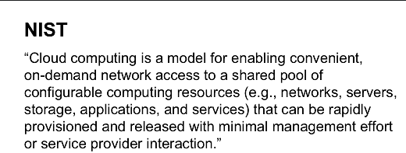

Slide 2

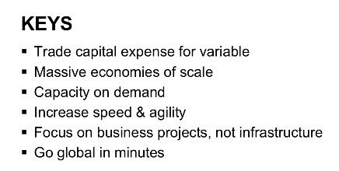

Slide 3


Slide 4
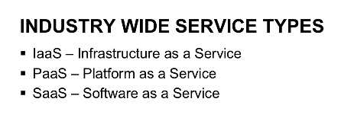

Slide 5
Assignment On Cloud computing PPT
Created By Rashmi Vernekar Keonics Hubli

